Slide 1
Initial prototype description and summary of key product features
Team Opioid Overdose Monitor
Ayham AlAkhras – Varsha Srinivasan – Min Ju Kim

Slide 2
Design Requirements
Cost effective (100 CAD budget)
Monitors blood oxygen level and respiratory rate reliably
Lightweight and small
Discrete
Editable emergency contacts
Quick response to overdose indicators
Long battery life

Slide 3
Subsystems
Electrical
Varsha
USER INTERFACE
Ayham
SIGNAL PROCESSING
Min ju

Slide 4
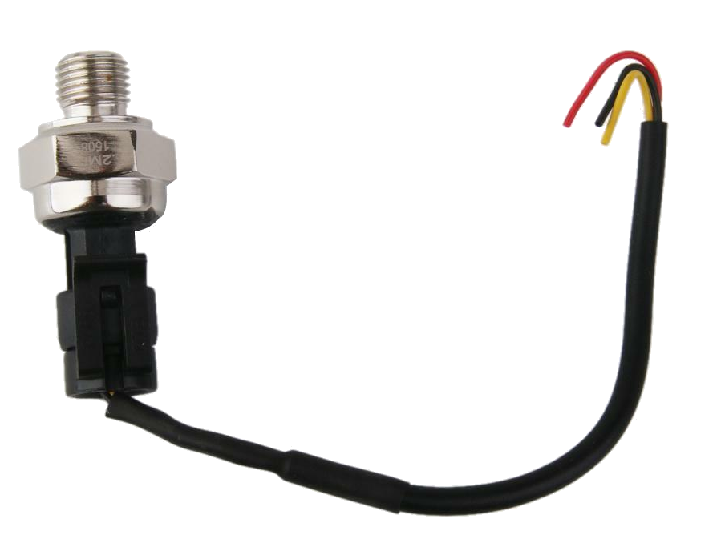
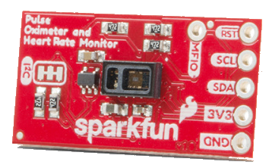
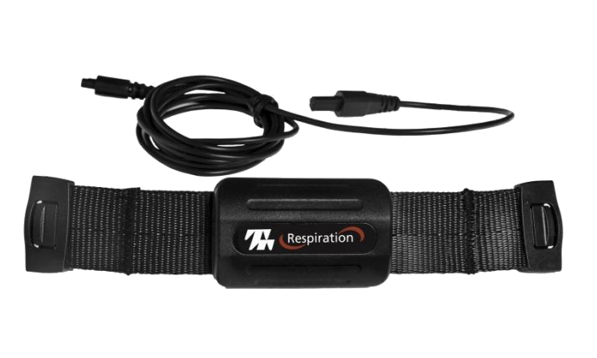
Design Philosophy

Slide 5
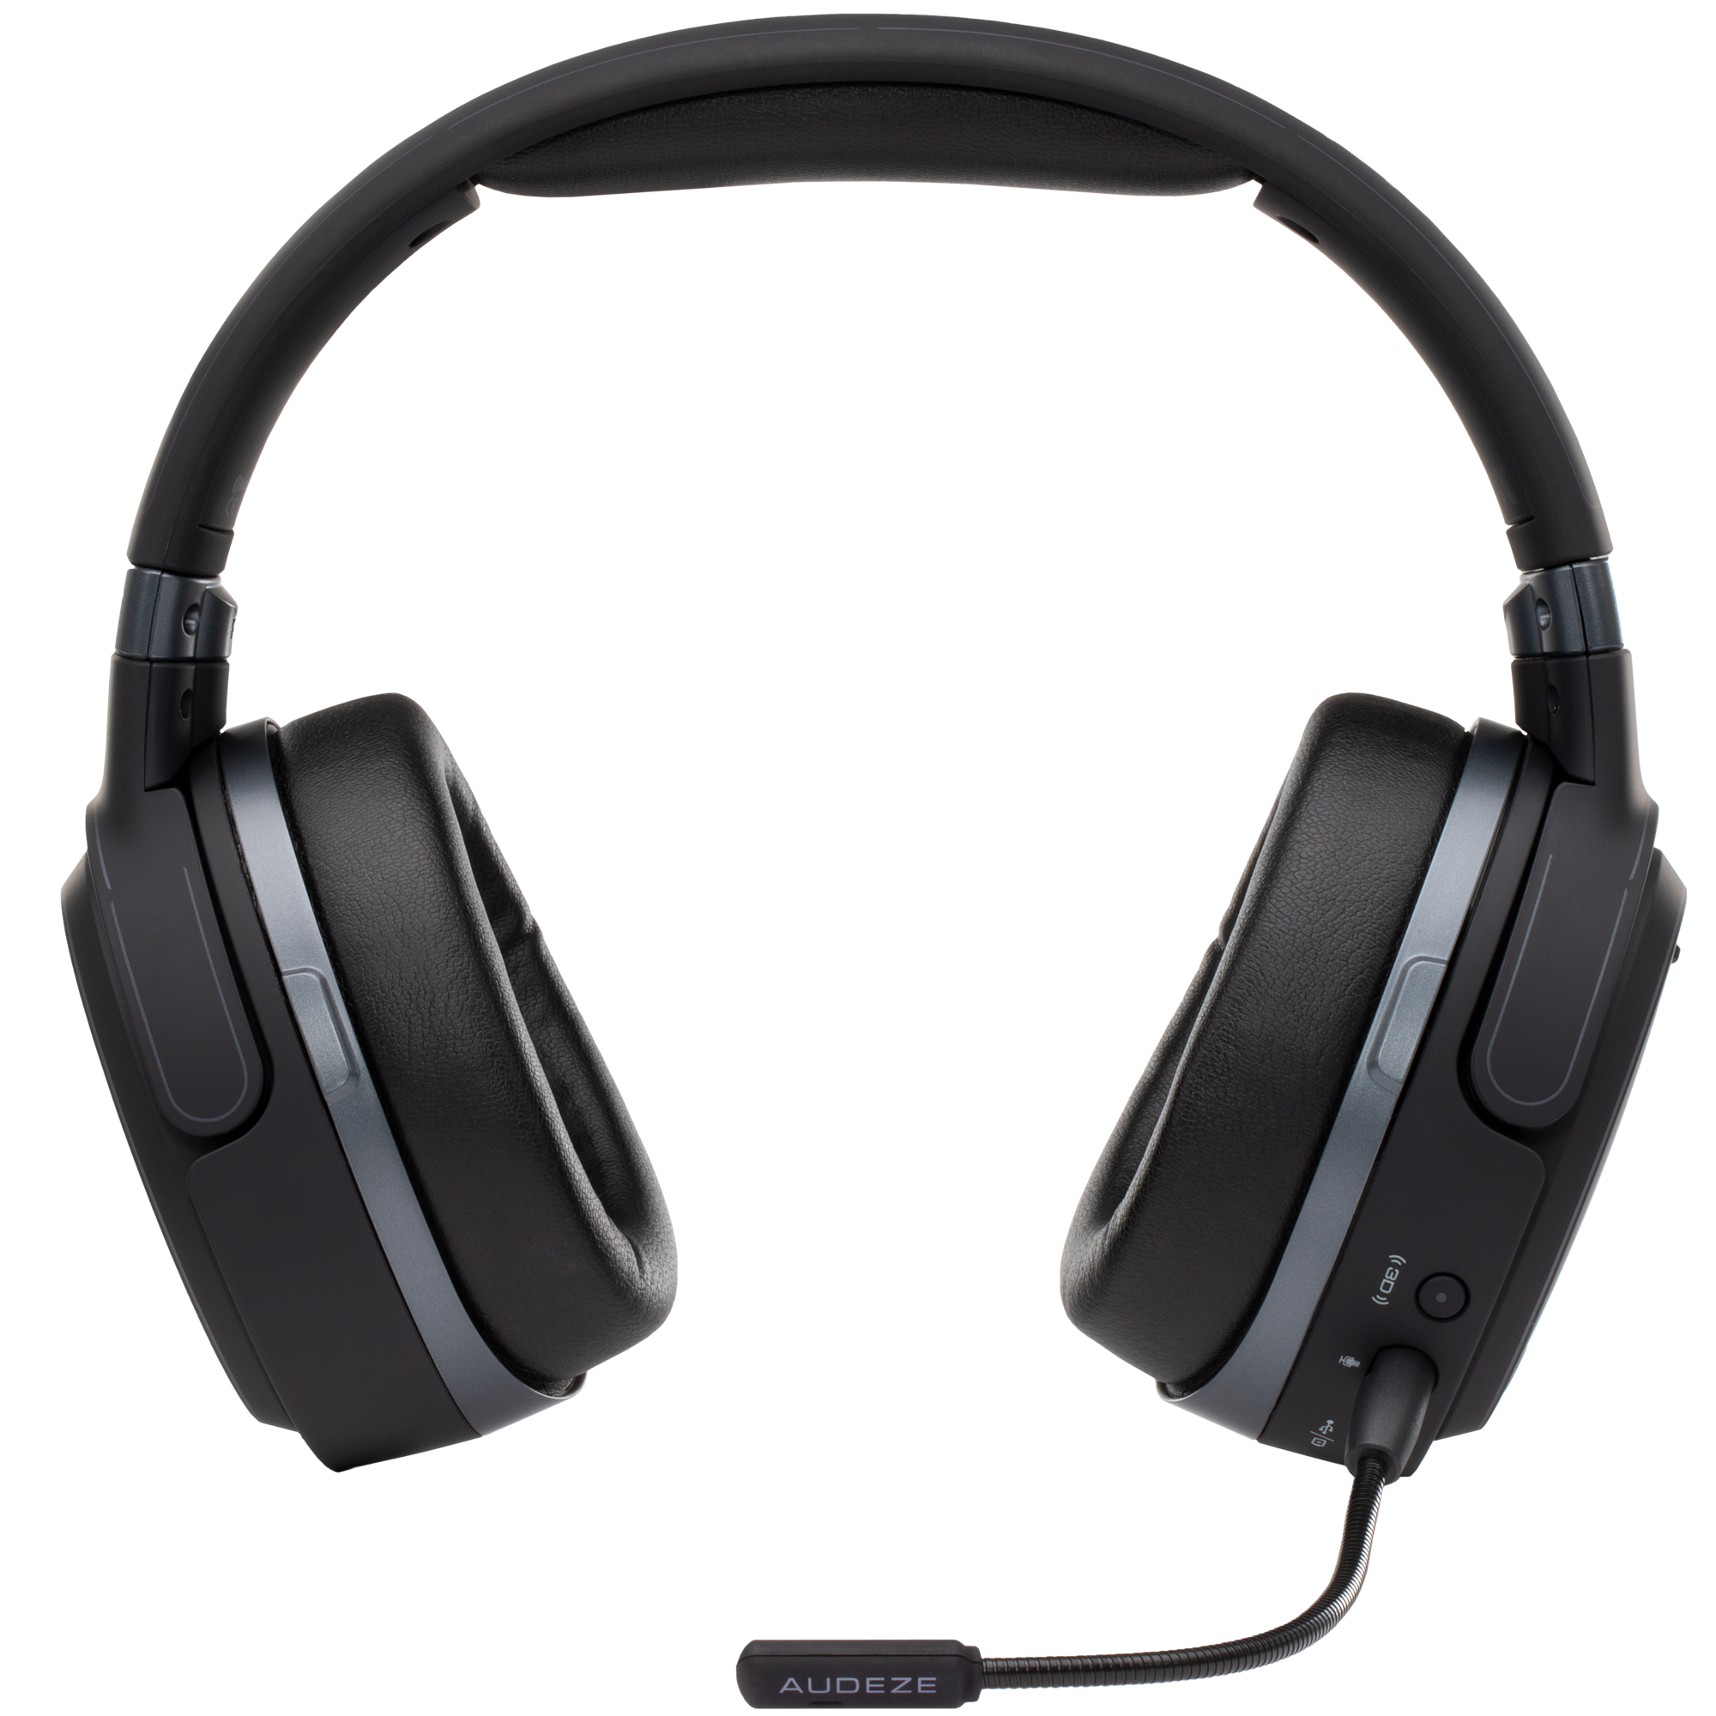
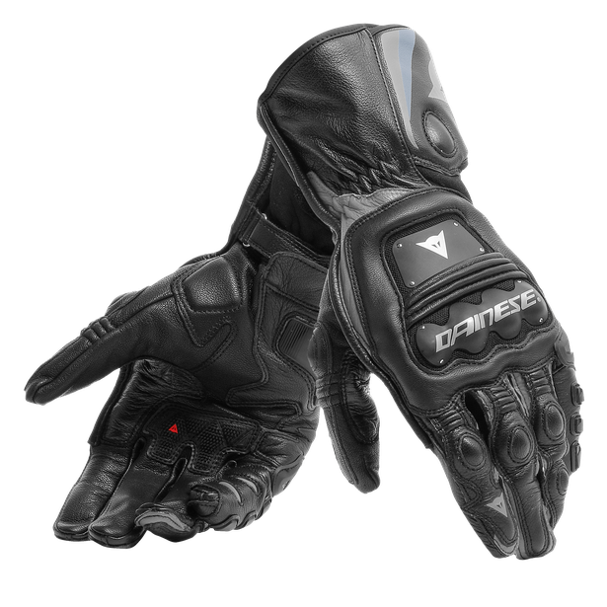
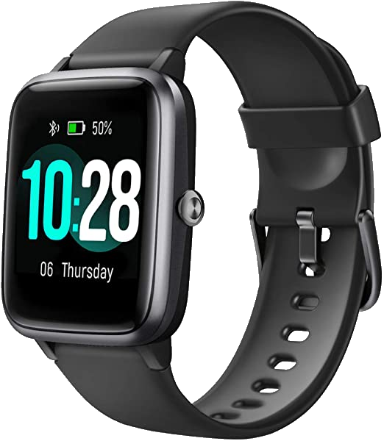
Design Solutions

Slide 6
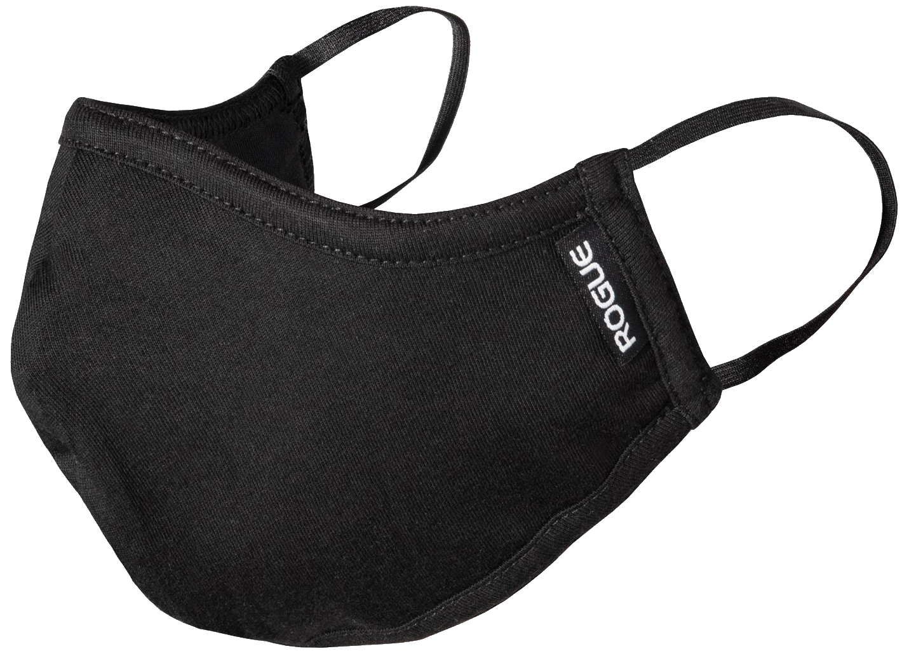

Slide 7
Prototypes
Circuit diagram and simulation
Physical circuit prototype
User interface drawings
User interface software
Signal processing prototype
Ergonomic prototype
Comprehensive prototype

Slide 8
Circuit Diagram and Simulation
Utilizes TinkerCAD, online Arduino simulation software
Tested with simple components
Verifies connection diagram

Slide 9
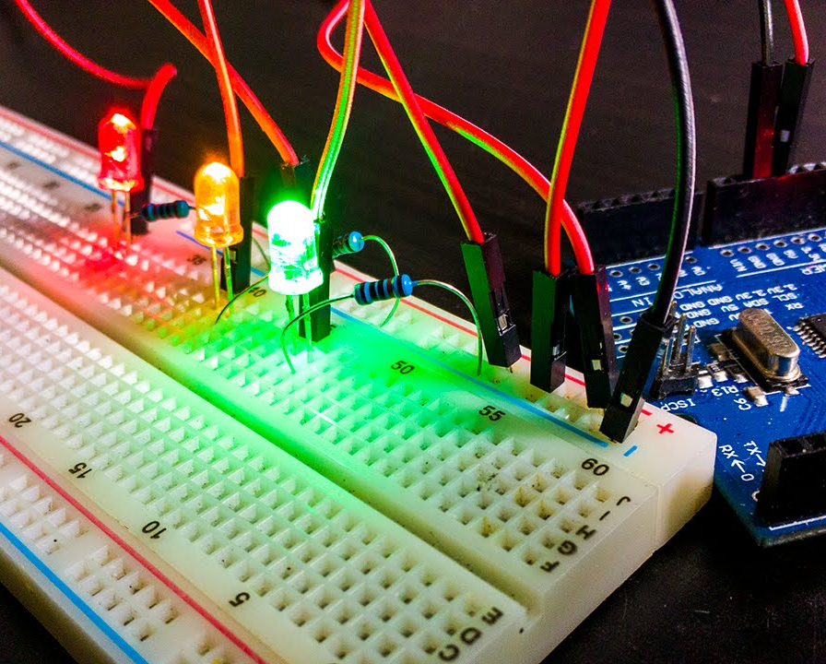
Physical Circuit Prototype
Utilizes a breadboard and jumper wires
Barebones prototype of measurement system
Tested using real input and simple output to serial port
Data extracted dictates the signal processing prototype

Slide 10
User Interface Drawings and Software
Verifies general UI design
Tested in focus groups to brainstorm opinions and adjustments
No functionality yet

Slide 11
Where We Stand Now
Circuit parts selected, in contact with Maker Space to confirm orders
UI drawings complete
Undergoing transition from UI drawings to software
Meeting set up with the client to confirm design details
Circuit diagram completed and simulation in progress
Concern with getting parts in time
Overall on track to create a working comprehensive prototype for design day

Slide 12
Team Management
Small team of 3 people
Good individual workers
Excellent communication
Assign clear tasks and deadlines
Firm and collaborative decision making
Bulk of documentation done at the end

Slide 13
Thanks! Any questions?

