Slide 1
Life Cycle Analysis: Inclusive Bike
GNG5140 – Engineering Design
Presented by: Jonathan Horton, Sachin Kasbekar, Gaurang Lele, Kristina Prasad, Raghav Kaushik Vagata Umesh
Faculté de Génie | Faculty of Engineering
uOttawa.ca
uOttawa.ca
Notes:
PAGE COUVERTURE (option 3) ÉBAUCHE (DOCUMENT NON FINALISÉ) À lire avant d’utiliser le gabarit
NOTE : Les éléments du gabarit suivants ne peuvent être modifiés : • Entête organisationnelle grenat (Université d’Ottawa | University of Ottawa) • Pied de page organisationnel comprenant la bande grise et grenat ainsi que le logo, à l’exception de l’adresse Web qui peut être modifiée en suivant les étapes suivantes : dans le document PowerPoint, cliquez sur l’onglet View, puis sélectionnez Slide Master. Sur le menu d’affichage (à gauche), sélectionnez la troisième diapositive et inscrivez la nouvelle adresse sur celle-ci.
COVER PAGE (option 3)
DRAFT ONLY (FILE NOT FINAL) Read before using template
NOTE: The following elements of the template should remain untouched and cannot be modified:
• Corporate (Université d'Ottawa | University of Ottawa) garnet header
• Corporate uOttawa footer including the grey/garnet stripe and logo, with the exception of the URL which can be customized to a specific URL by following these simple steps: On the PowerPoint View tab, in the Master Views group, select Slide Master. Select the third slide on the left side panel, and type in the desired URL on the slide.

Slide 2
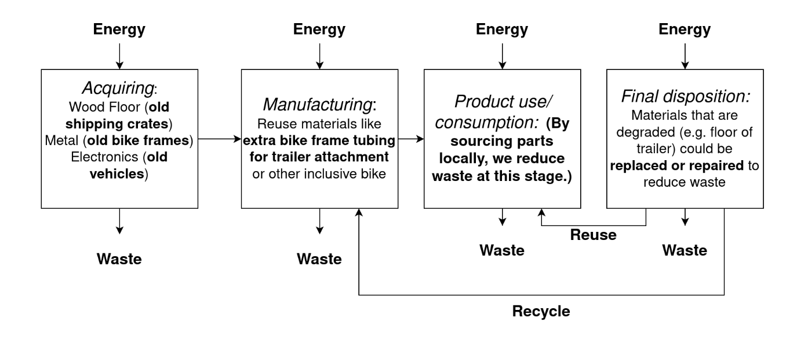
An Overview
2
Our product is made out of repurposed materials.
Notes:
PAGE INTÉRIEURE ÉBAUCHE (DOCUMENT NON FINALISÉ) À lire avant d’utiliser le gabarit
NOTE : Les éléments du gabarit suivants ne peuvent être modifiés : • Entête organisationnelle grenat (Université d’Ottawa | University of Ottawa) • Pied de page organisationnel comprenant la bande grise et grenat ainsi que le logo, à l’exception de l’adresse Web qui peut être modifiée en suivant les étapes suivantes : dans le document PowerPoint, cliquez sur l’onglet View, puis sélectionnez Slide Master. Sur le menu d’affichage (à gauche), sélectionnez la troisième diapositive et inscrivez la nouvelle adresse sur celle-ci.
INSIDE PAGE
DRAFT ONLY (FILE NOT FINAL) Read before using template
NOTE: The following elements of the template should remain untouched and cannot be modified:
• Corporate (Université d'Ottawa | University of Ottawa) garnet header
• Corporate uOttawa footer including the grey/garnet stripe and logo, with the exception of the URL which can be customized to a specific URL by following these simple steps: On the PowerPoint View tab, in the Master Views group, select Slide Master. Select the third slide on the left side panel, and type in the desired URL on the slide.

Slide 3
An Overview
3
Sustainable product development is the design and development of products that have a minimal impact on the environment*
Requires a holistic perspective that analyzes the total product development and life cycle of a product using Life Cycle Assessment (LCA) Analysis*
Our product can be made out of repurposed materials
*Professor David Bruce. Lecture 7. Design for Sustainability.
Image source: https://everydayrecycler.com/reduce-reuse-recycle/
Notes:
PAGE INTÉRIEURE ÉBAUCHE (DOCUMENT NON FINALISÉ) À lire avant d’utiliser le gabarit
NOTE : Les éléments du gabarit suivants ne peuvent être modifiés : • Entête organisationnelle grenat (Université d’Ottawa | University of Ottawa) • Pied de page organisationnel comprenant la bande grise et grenat ainsi que le logo, à l’exception de l’adresse Web qui peut être modifiée en suivant les étapes suivantes : dans le document PowerPoint, cliquez sur l’onglet View, puis sélectionnez Slide Master. Sur le menu d’affichage (à gauche), sélectionnez la troisième diapositive et inscrivez la nouvelle adresse sur celle-ci.
INSIDE PAGE
DRAFT ONLY (FILE NOT FINAL) Read before using template
NOTE: The following elements of the template should remain untouched and cannot be modified:
• Corporate (Université d'Ottawa | University of Ottawa) garnet header
• Corporate uOttawa footer including the grey/garnet stripe and logo, with the exception of the URL which can be customized to a specific URL by following these simple steps: On the PowerPoint View tab, in the Master Views group, select Slide Master. Select the third slide on the left side panel, and type in the desired URL on the slide.

Slide 4
Life Cycle Analysis
Image source https://populationeducation.org/what-is-a-life-cycle-analysis-and-why-is-it-useful/

Slide 5
1. Material Extraction
Images
https://www.cyclingnews.com/features/how-are-bicycles-made-from-mine-to-market/
https://www.smartsign.com/recycle-labels/recycle-metal-label/sku-s-4991

Slide 6
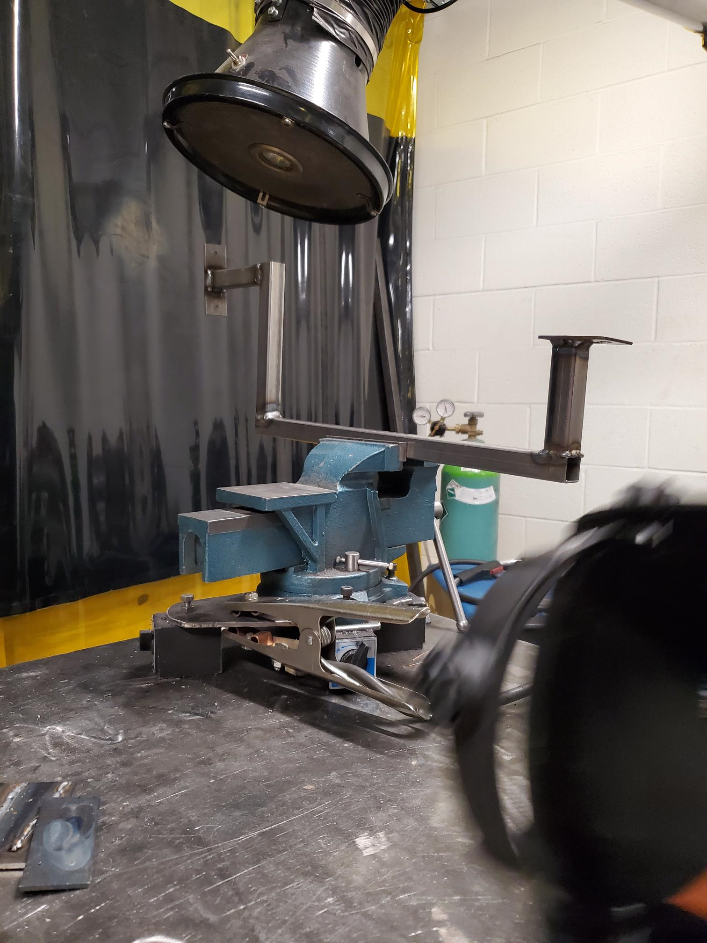
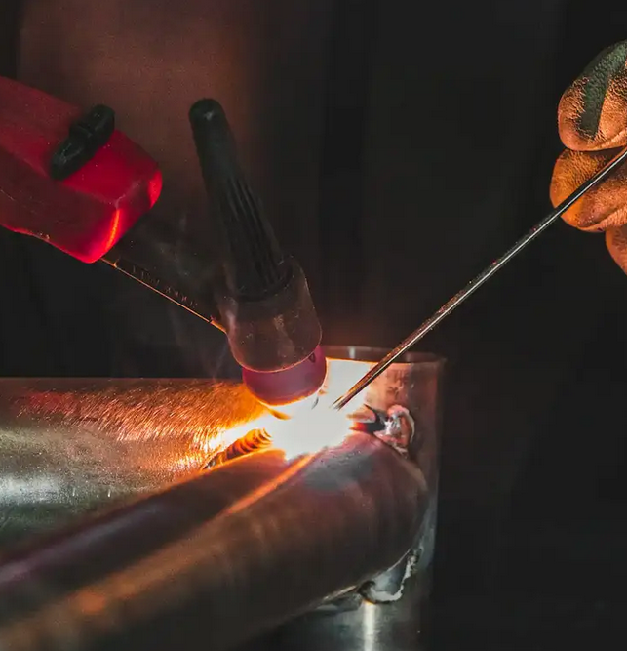
2.Manufacturing
Design
Cutting of the tubes
CNC machining
Welding
Painting
Floor and ramp acquisition/manufacturing
Electronics acquisition/manufacturing
Shipping
We could also work with local bike shops/coops to reuse parts and have them manufactured locally at a shop with welding equipment.
Right image: https://campmajobikes.com/en/custom-bicycle-manufacturing-process/

Slide 7
3. Distribution
The trailer can be distributed by cargo ships and trucks in boxes in parts and assembled by the final user with the guidance of the manual.
Work with local distributers if manufactured locally.
Local welding/bike coop example:
Image sources: https://blog.intekfreight-logistics.com/freight-shipping-options
https://ottawavelooutaouais.com/2018/08/12/university-of-ottawa-bike-co-op-how-to-get-there-from-the-main-campus/

Slide 8
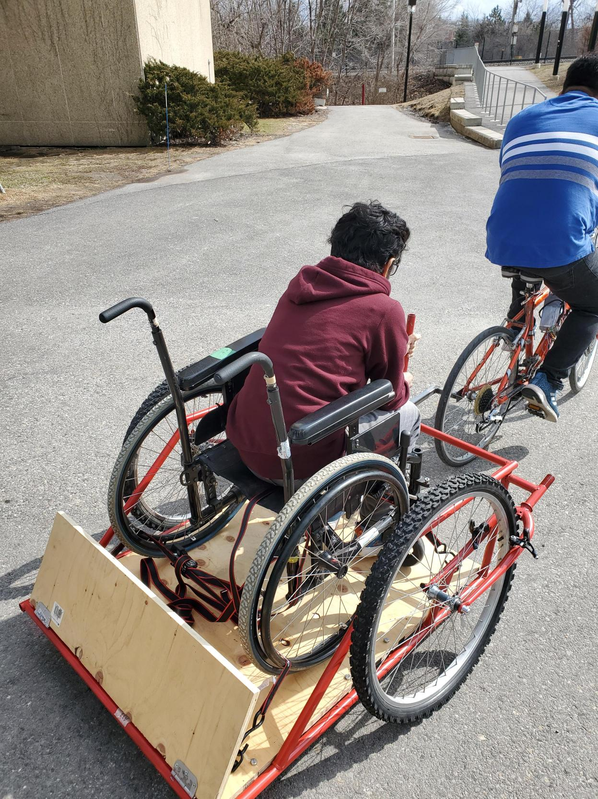
4. Usage
The sturdily constructed metal trailer can be used for a prolonged period of time and is easily maintained. The trailer wheels are standard 26” bicycle wheels, which is why they can be easily replaced or repaired in case of need.
The trailer aligns with 3 UN goals:
(1) Goal 3. Good Health and Well-Being
(2) Goal 10. Reduced Inequalities
(3) Goal 11. Sustainable Cities and Communities

Slide 9
5. End of life management
Most of the trailer is constructed of metal, which means it can be recycled and reused. Wood is biodegradable. For electronics, repurposing light systems from old cars/motorcycles could be an option to reduce footprint.
Image source https://www.smartsign.com/recycle-labels/recycle-metal-label/sku-s-4991

Slide 10
THANK YOU FOR YOUR ATTENTION!
ANY QUESTIONS?

