Slide 1
THE EQUICYCLE
GNG 5140 - Engineering Design

Slide 2
Engineers At Work
First Year Masters of Engineering students
Raghav Kaushik Vagata Umesh
Gaurang Lele
Sachin Kasbekar
Jonathan Horton
Kristina Prasad

Slide 3
Strategic Collaboration With Client
Our client, Justine Boudreau, engaged in discussions with individuals with disabilities. These individuals expressed their desire for leisure bike rides, wanting to enjoy outings with their friends and family.
As per the insights and the requirements shared with us for the final product we have a list of the requirements that we fulfilled for this design.
Specific Requirements
A carriage that ensures safety and security.
A sturdy and reliable mounting system for the wheelchair.
A secure and stable connection between the bike and the carriage.
A comprehensive indicator and braking system.

Slide 4
Driven by Purpose
As engineers, we have the ability to create change in people’s lives.
We strive to provide our communities with meaningful and sustainable solutions.
We possess the ability to quickly but thoroughly come up with solutions which can be implemented.

Slide 5
Identifying Challenges
Recreation is crucial for a healthy mind.
Differently abled people are generally unable to enjoy outdoor recreation due to their disabilities.
Especially for people who are wheelchair bound.
Cycling boosts your mood and release feel good hormones.
Options in the market are fairly limited.

Slide 6
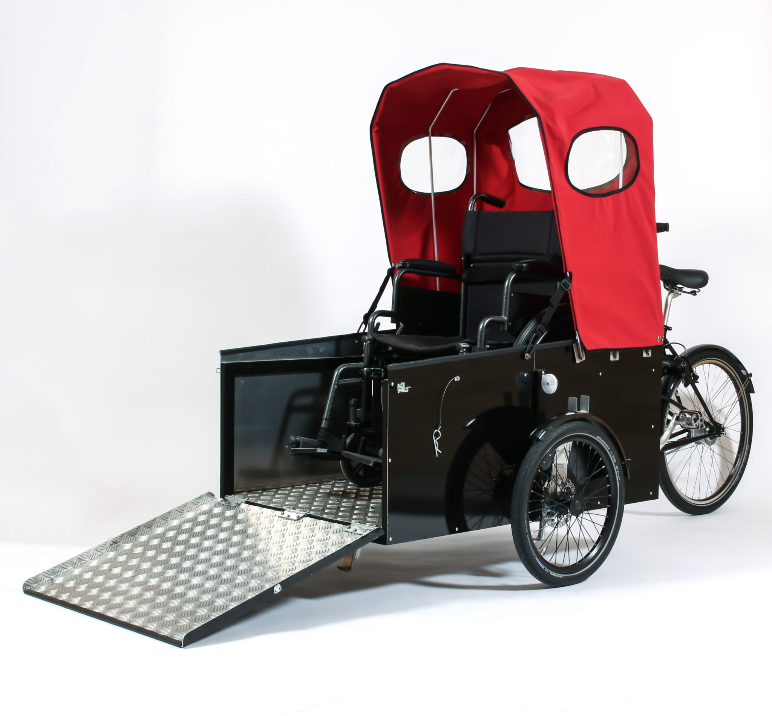
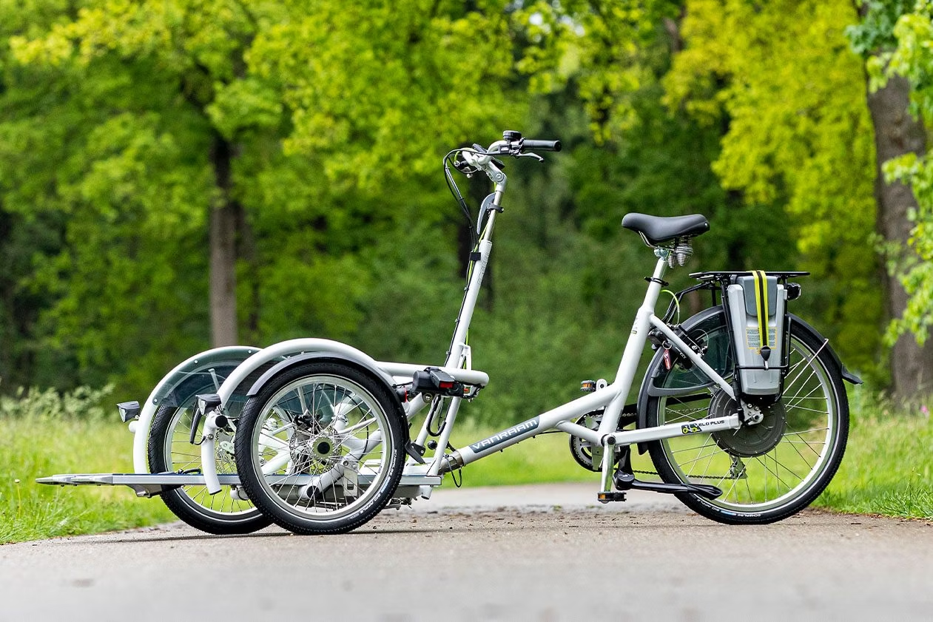
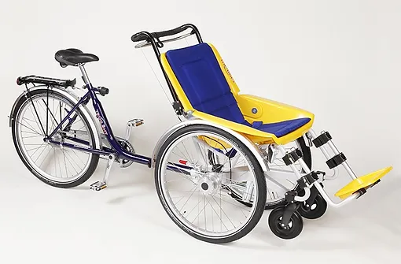
Present Competitors
The Duet
Nihola Flex 2
Vanraam VeloPlus
Notes:
All three - Expensive, complicated steering system
Nihola - bulky
Vanraam - difficult to turn
Duet - Wheelchair needs to be removed from the picture

Slide 7
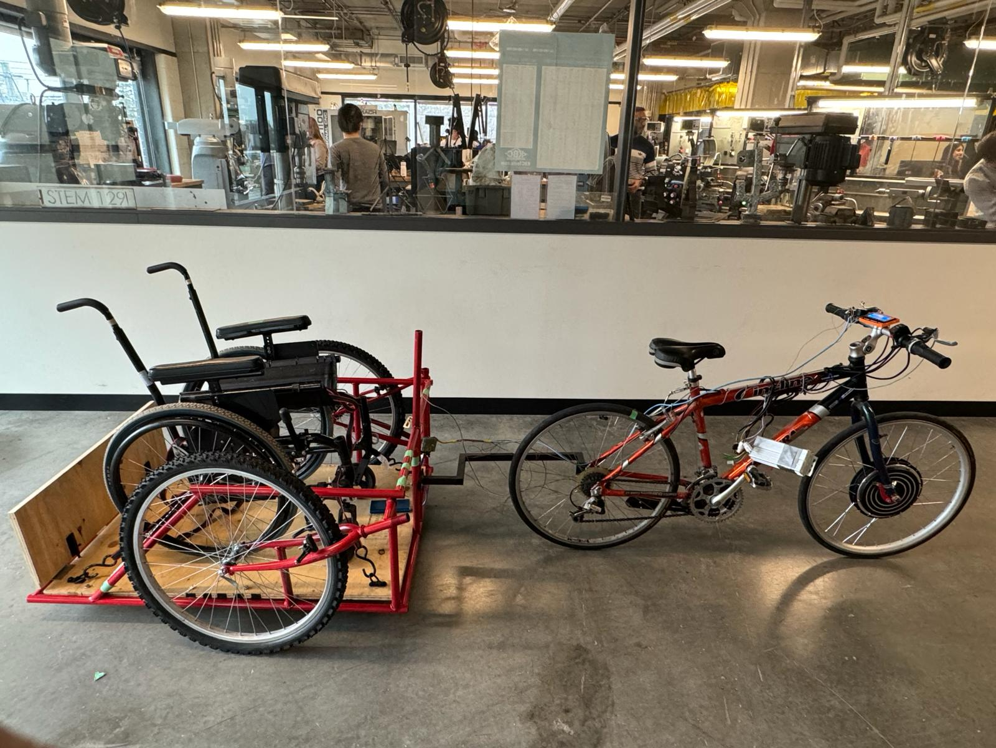
Why us?
Our solution has has been designed, tested and made nearly production ready at 1/40th of the cost of alternatives available.
We have designed a safe and sturdy base along with an easy to use mount system.
Fits all sizes of wheelchairs and bikes upto a total weight capacity of 150 kgs.
A system to strap the wheelchair into the carriage.

Slide 8
Unique Selling Point (USP)
Safety has always been the driving thought of this solution. Hence, we have integrated an electronics system into the carriage.
The electronics system consists of brake lights, turning lights, an LCD display and indicators for the bike driver.
None of the alternatives have such a system even with their high prices.
Our system ensures the rider and driver are in sync with each other and the rider can indicate their intentions to everybody else on the road.

Slide 9
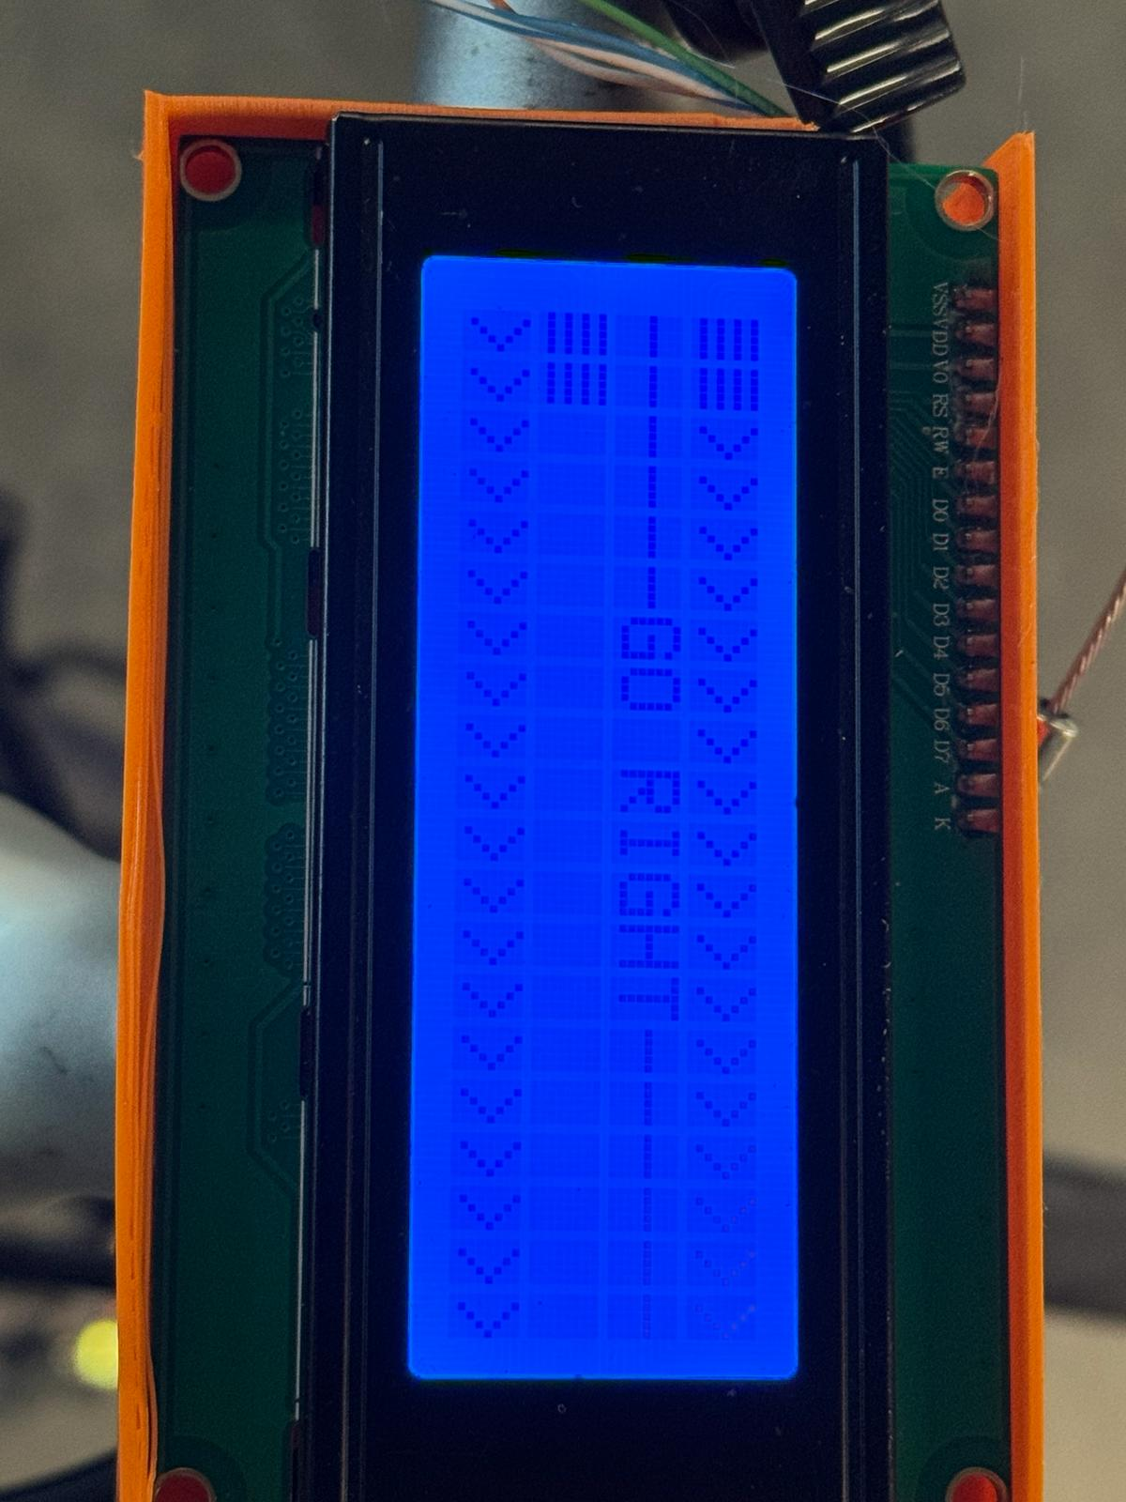
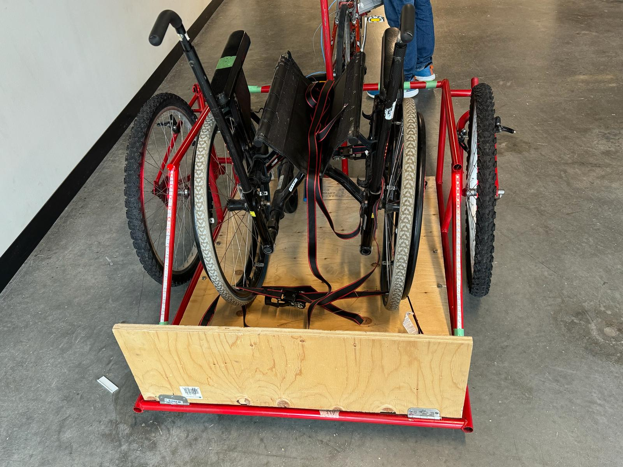
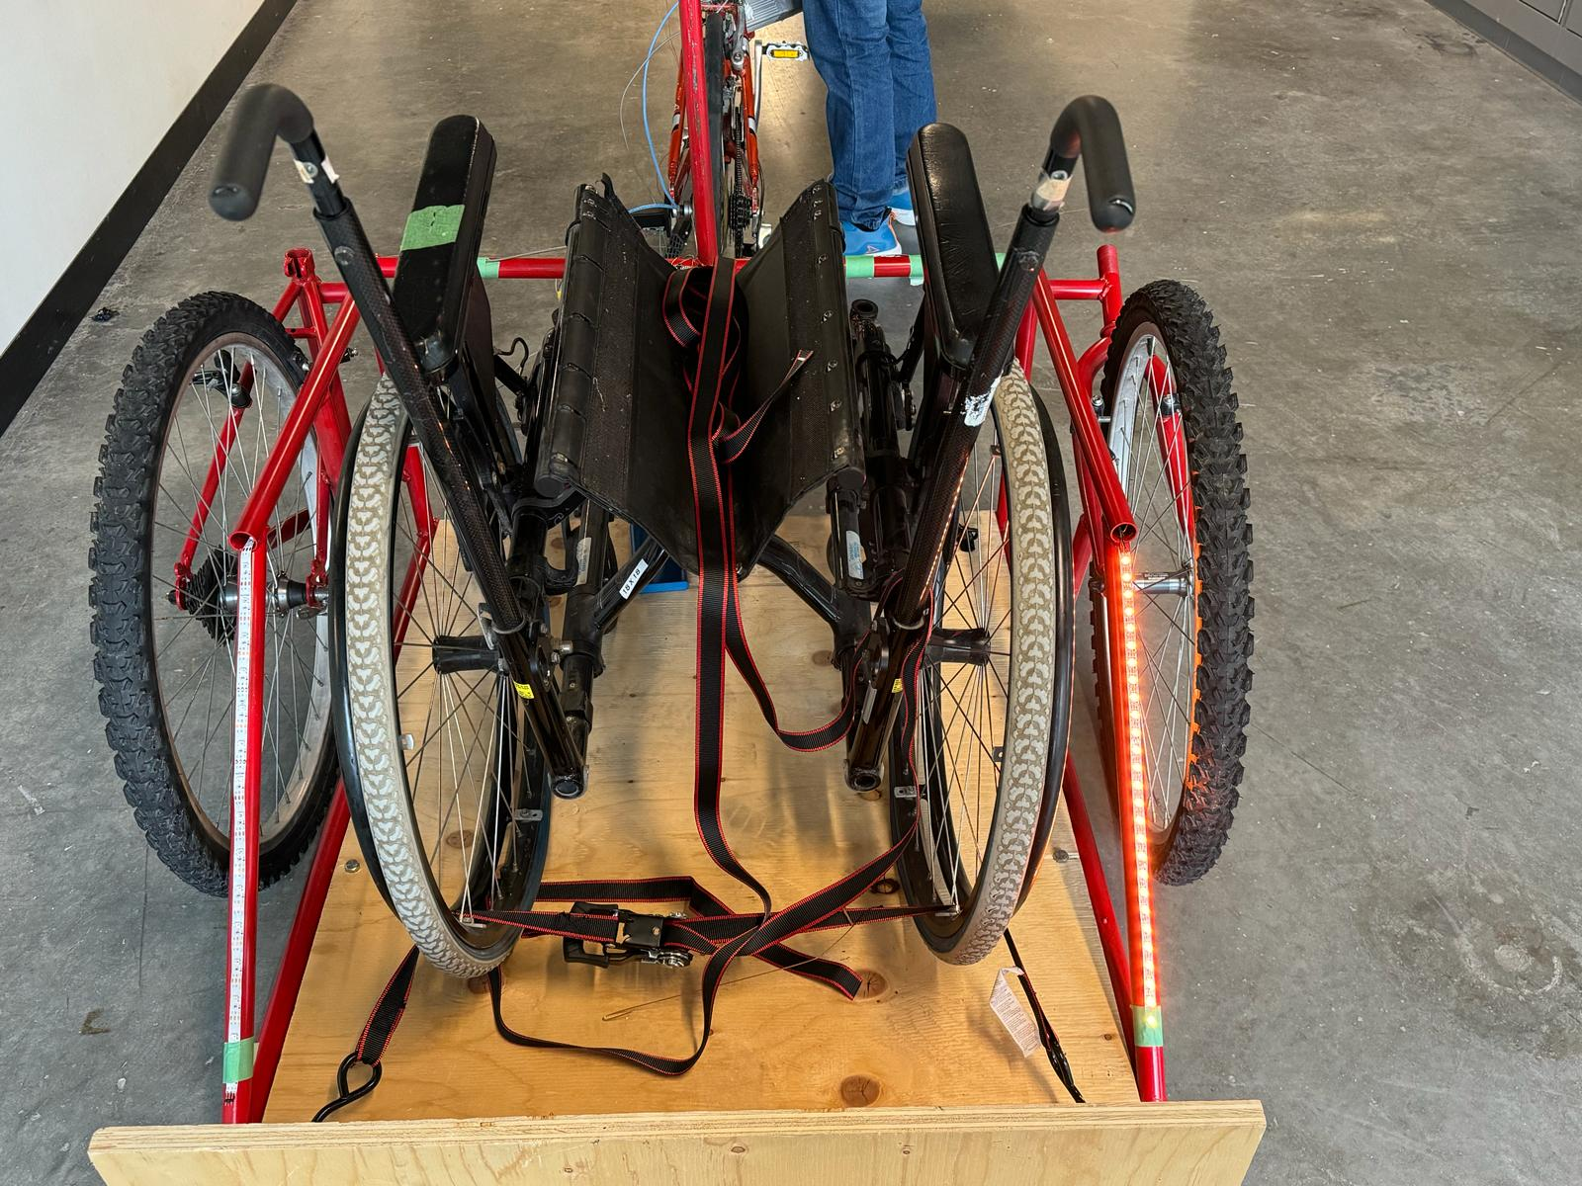
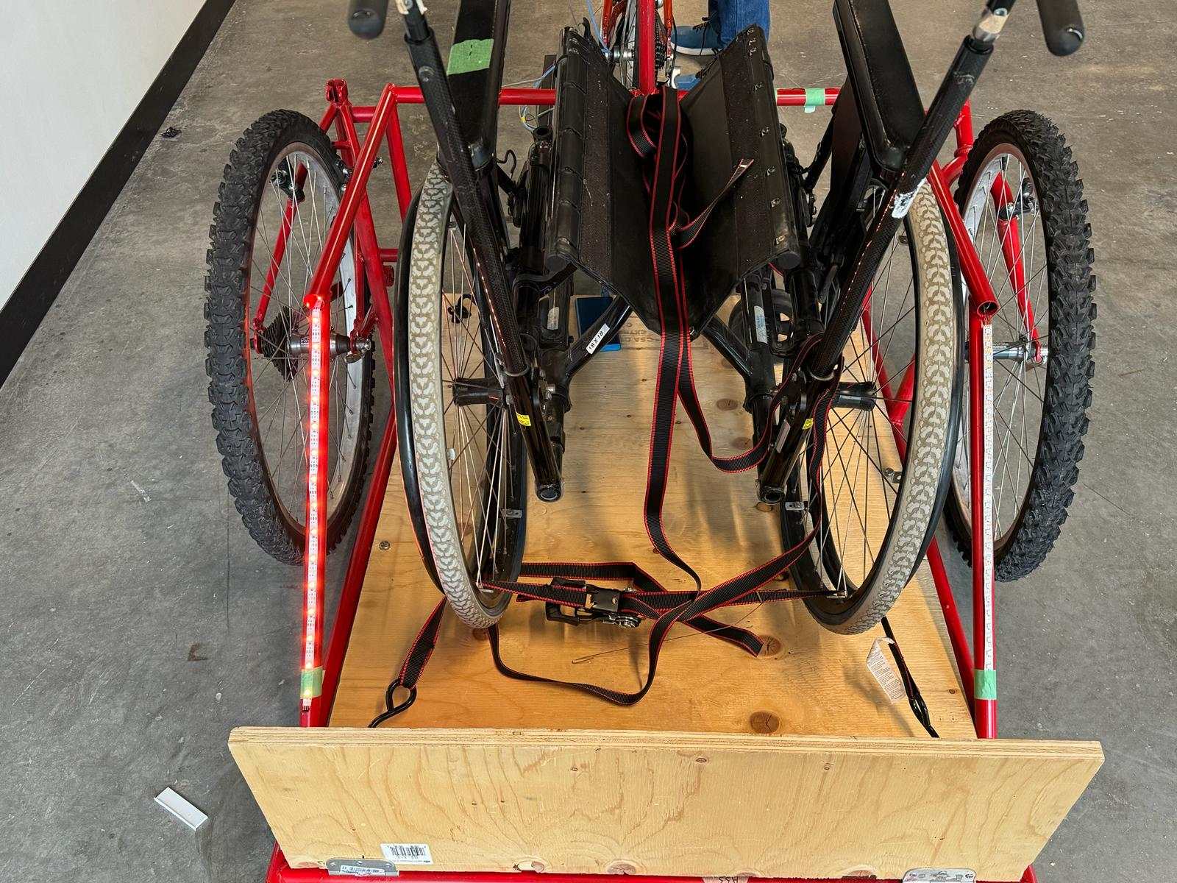

Slide 10
THANK YOU

